Slide 1
Wide Attack Battles
[DATE]

Slide 2
Analysis Scope
Season: WSL 2023-2024
Object: Actions after a player receiving a pass in the Wide Attack Area.
Wide Attack Area: outside of the box and in the attacking third.
Methods:
Define the success (attacking-wise) of the sequence following the pass.
Quantify the difficulty of context as to gaining success
Modeling to reveal the variance of result that can be explained by the context
Extract cases where an attacker gained success under difficult to attack context, and where a defender prevent success under easy to attack context.
Rank players accordingly

Slide 3
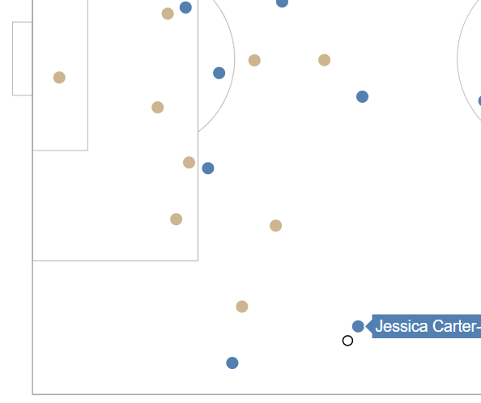
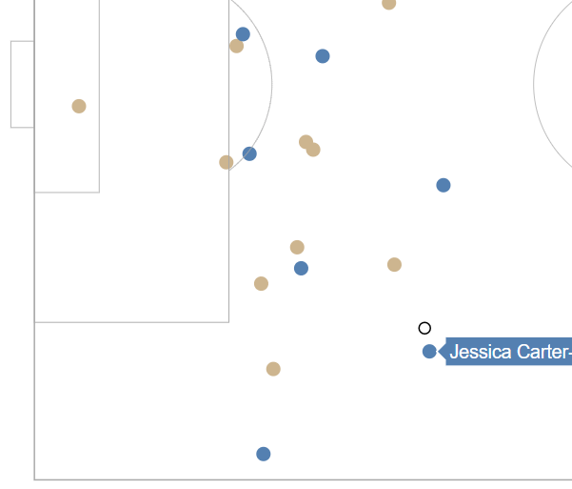
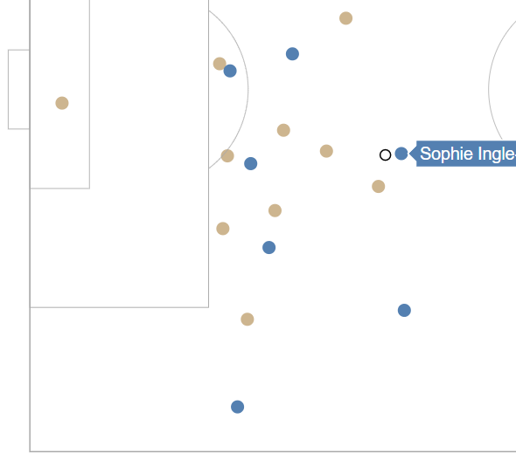
1 Define Success of Sequence
Start of sequence: the frame when the distance between the ball and the receiving player is less than 2 meters.
End of sequence: the second pass or shot event after the start of sequence.
A sequence is defined as success if it fits the criterias below:
The ball's new location is 2 meter closer to goal than where it was at the start of sequence.
The attacking team continuously holds possession until the ball moves to the location described above.
Start of sequence
Ball to goal distance: 42.04 m
Start of sequence
Ball to goal distance: 40.38 m
Start of sequence
Ball to goal distance: 34.68 m - Success
During this project, the location of possessing player was used to indicate the ball location, as event frames were marked during the passes at which the ball was away from where the player last possessed it.

Slide 4
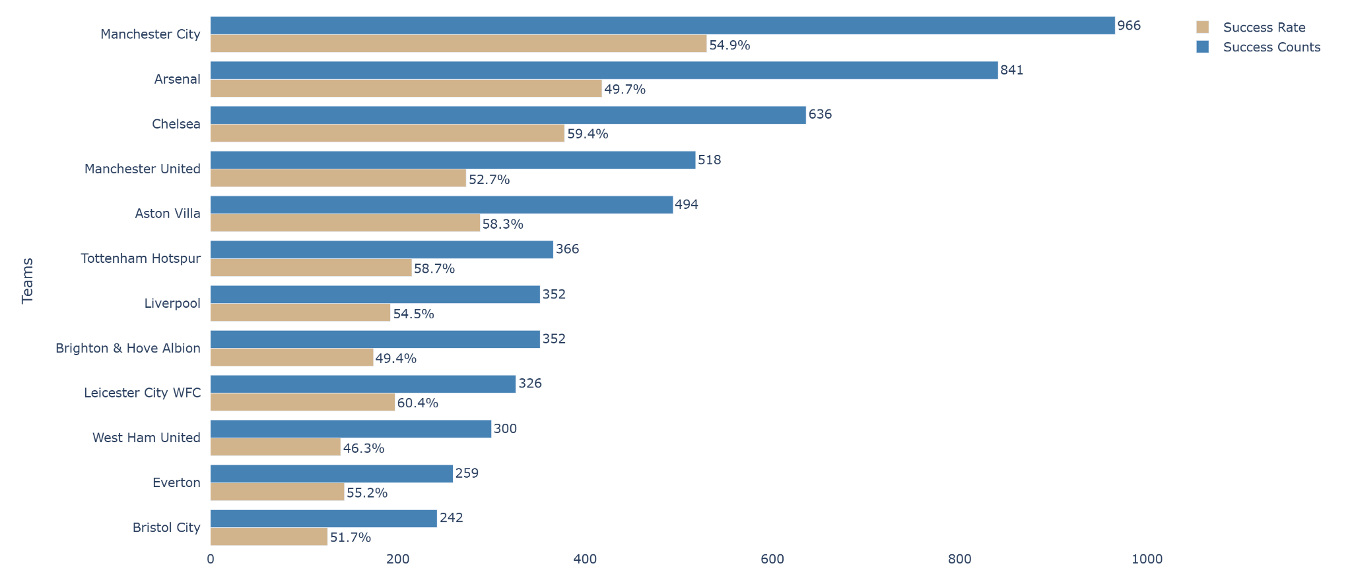
2 Team Performance
Manchester CIty and Arsenal seat on the top as to the count of successful sequences.
However, some teams with a much lower counts ends with an nice success rate - Leicester City succeeded 60.4% of all the wide attack sequences.

Slide 5
2 Context Variables
As the team performance differs, each sequence faces difference attacking difficulties. Here are a few variables considered to have influences on the sequence result.
Score difference
The scoring situation at the moment can affect players' intention of being aggressive or not. It also potentially reveals the skill level difference between the teams.
Count of defender in the box
With a sufficient number of defenders in the box, the main defender of the sequence has more freedom to leave a space behind and press hard, thereby increasing the attacking difficulty.
Count of attacker (above the attacking point)
From the 2 meters behind ball location to the goal line, all the attackers within this zone are considered as potential helpers to assist the sequence.
Team
Whether playing at a home stadium is commonly considered to have influence on the team's performance
Sum of Freedom
The space in which the attacker can move to with relatively lower threat. This is calculated using Voronoi diagram and explained in the next page.

Slide 6
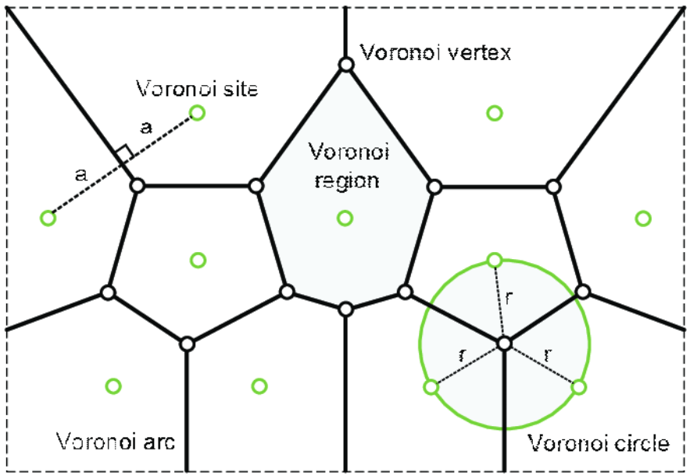
2.1 Sum of Freedom
[A Voronoi diagram is a type of tessellation pattern in which a number of points scattered on a plane subdivides in exactly n cells enclosing a portion of the plane that is closest to each point.]
Simply said, any point on the edge between two green circles in the pic has equal distance to each circle. Any point within a green circle's Voronoi site is closer to this circle than any other circles.

Slide 7
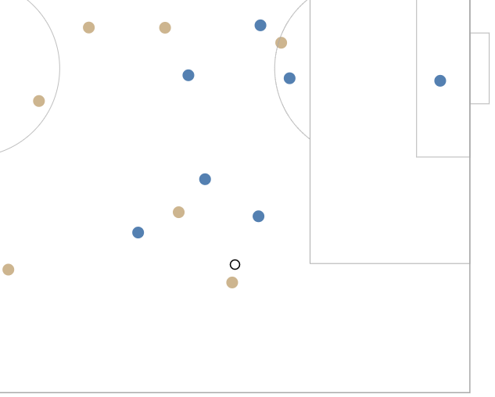
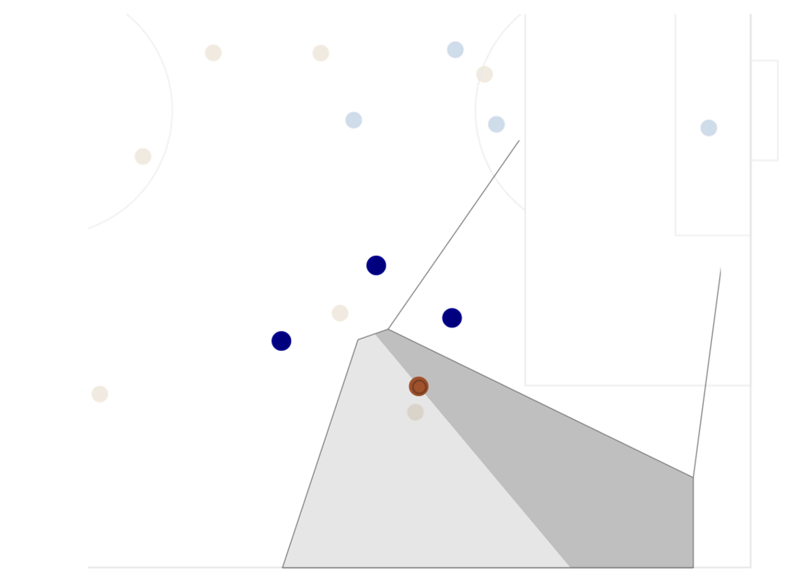
2.1 Sum of Freedom
For each sequence, a Voronoi site was calculated on the ball and nearby defenders. The site is divided by a line perpendicular to the line between ball and center of goal. The Sum of Freedom is defined as a sum of the site area closer to the goal and the are further from the goal, a heavier weight was applied to the closer area.
The boundary of the Voronoi diagram was the sidelines, goal lines, and 20 m away from the ball to four directions.
SoF = log(A_{far} + 1) + A_{close}
Eg1. SoF = 166.9 m² Result: Success
A_{far}
A_{close}

Slide 8
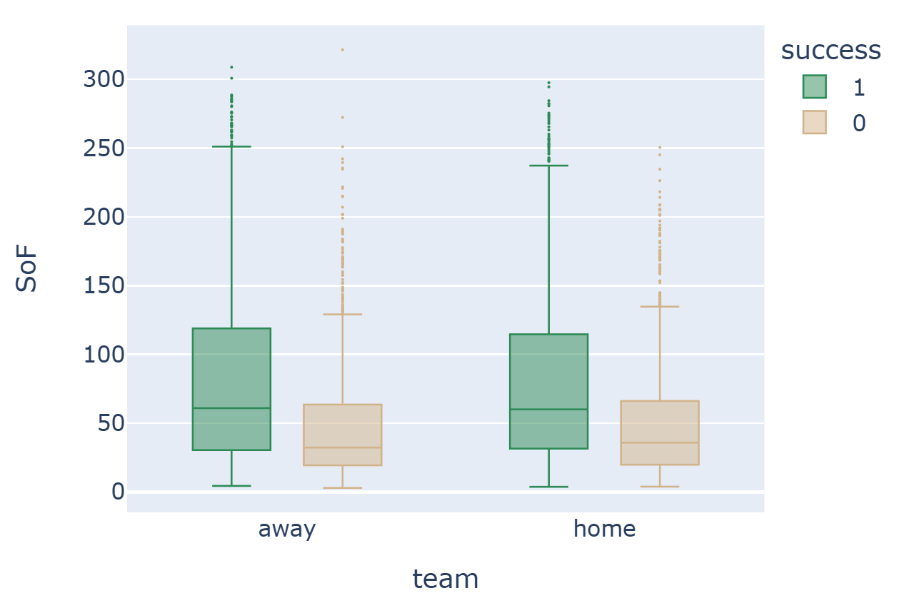
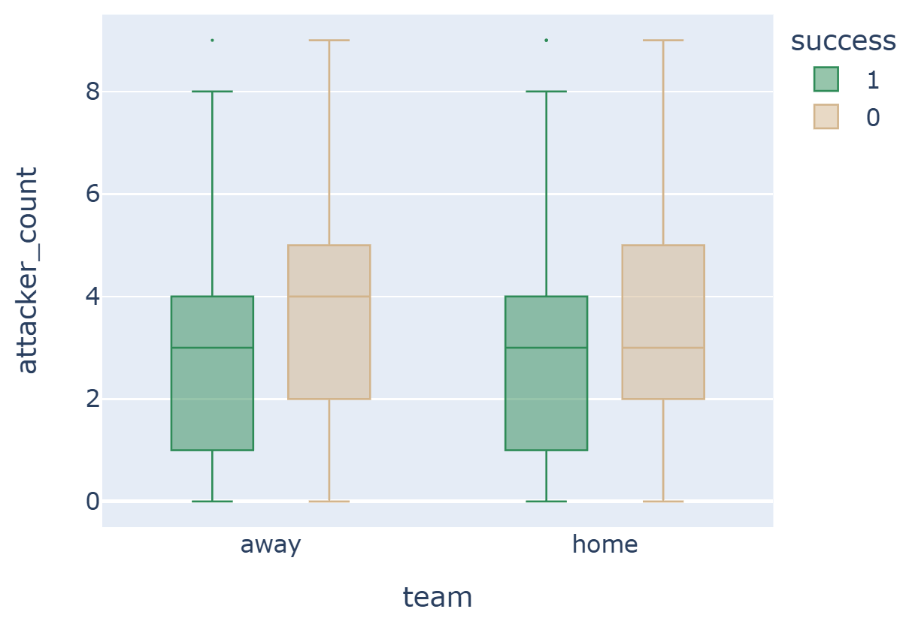
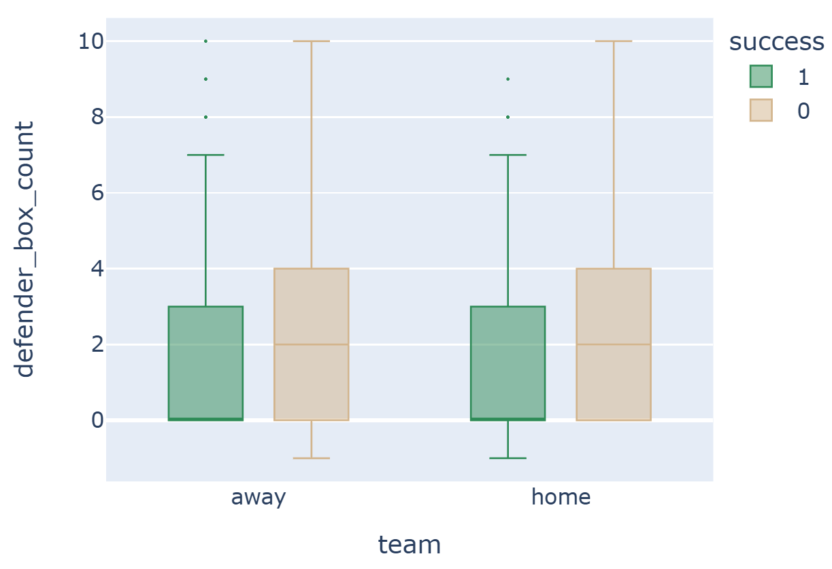
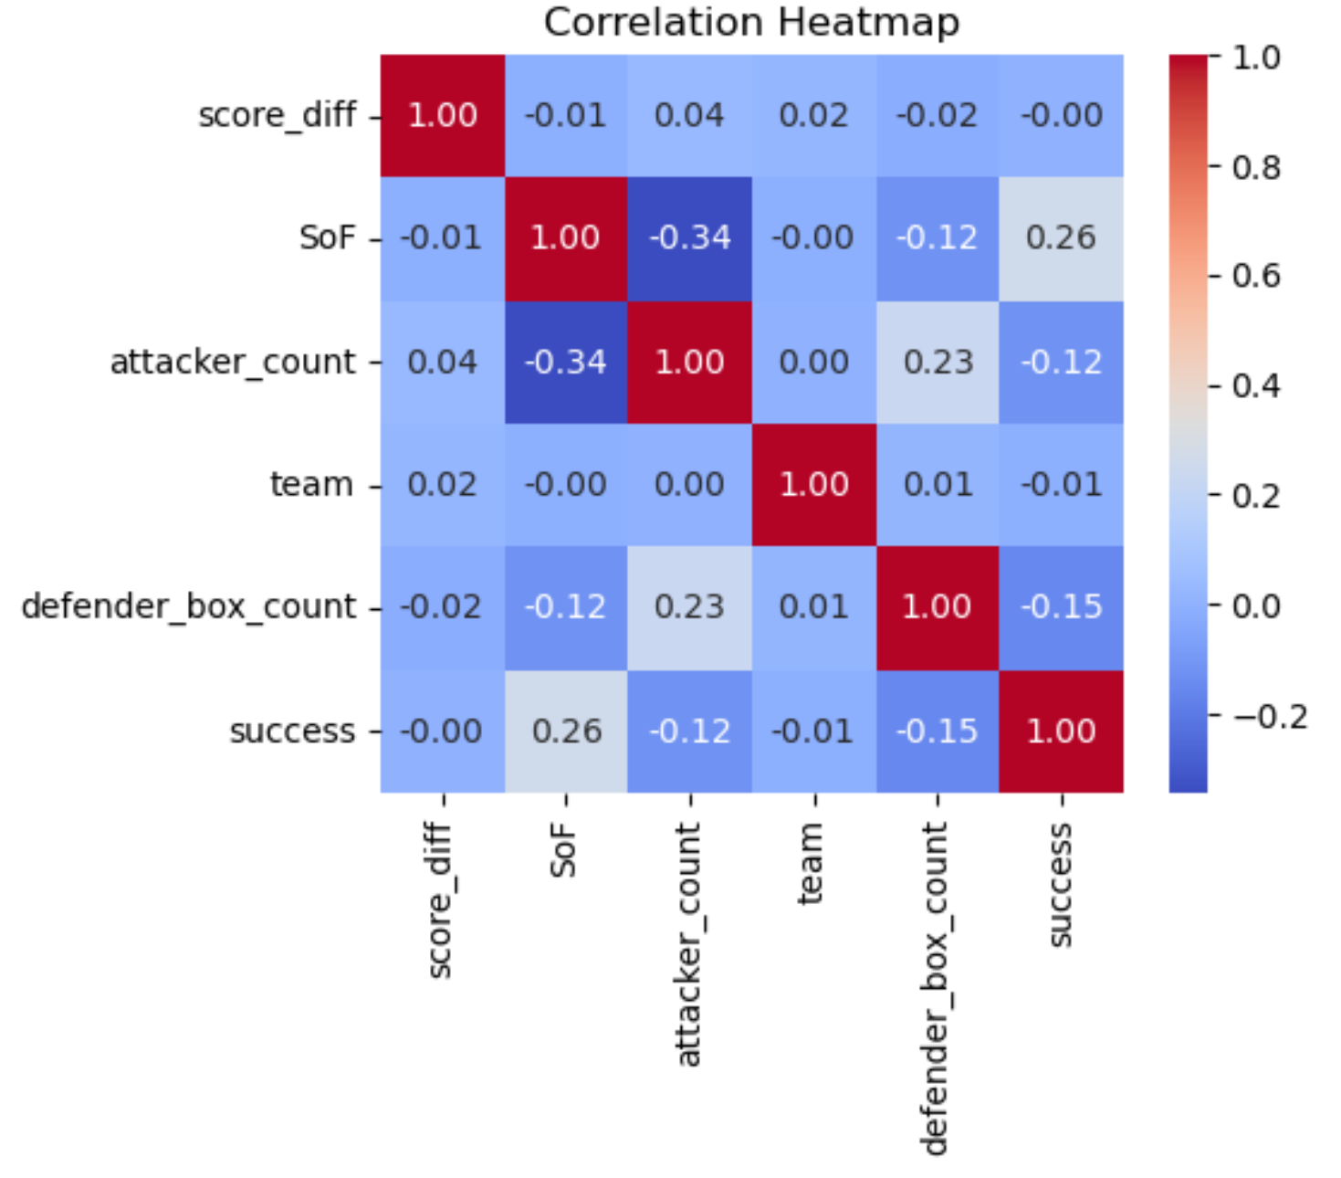
2.2 Feature exploration
A few feature exploration reveals the significance of SoF, defender_box_count, and attacker_count to the sequence result.

Slide 9
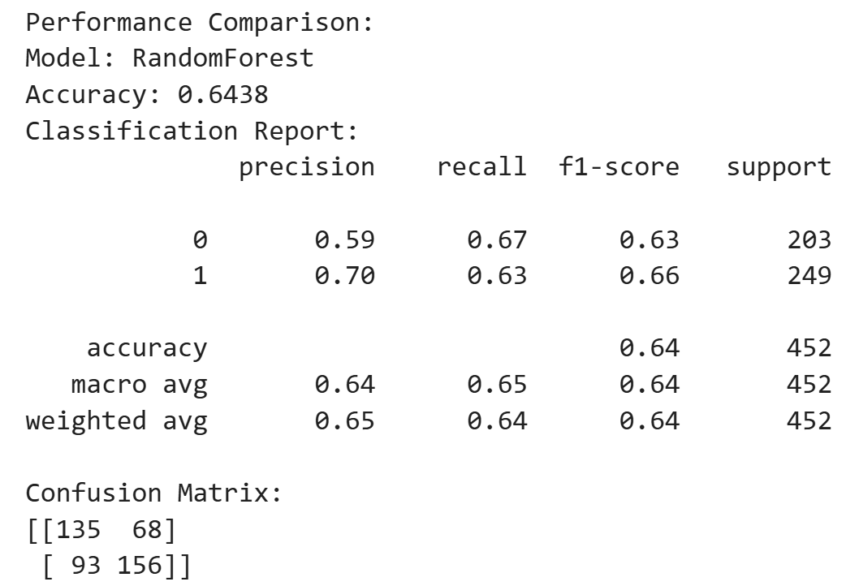
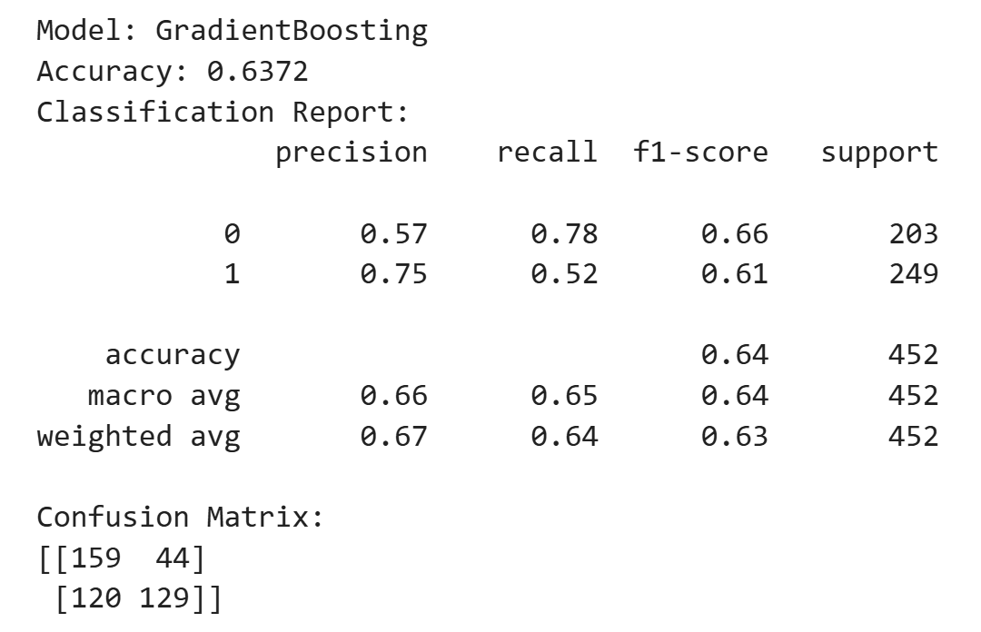
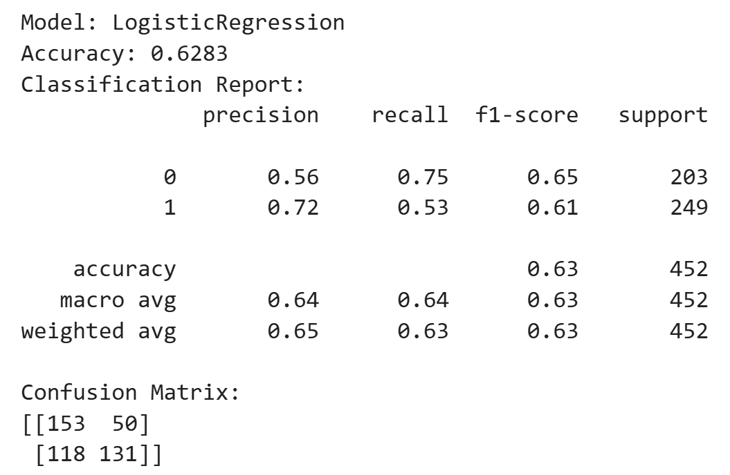
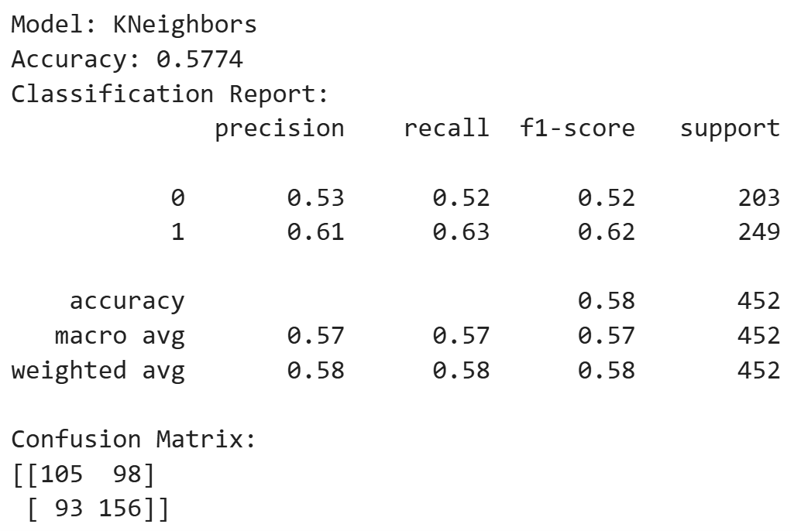
3 Models
Using the variables mentioned as features, a few classification models were trained to reveal how much variance of the sequence result can be explained by contextual influences.
In the report on the right, label 1 represents success, label 0 represent unsuccess.

Slide 10
4 Player Evaluation
The variance that were not explained by contextual influences should be heavily influenced by the players' capabilities:
Outstanding attackers would succeed on scenarios which the model considered to be difficult to succeed.
Outstanding defenders would prevent an attacking success on scenarios considered to be easy to succeed.
3392 randomly selected sequences were left out before the model training and was used for player evaluation.
Among the four models, the GradientBoosting model was chosen to evaluate attacker, because of its better performance on label 0 (unsuccess), the RandomForest model chosen to evaluate defender, because of its better performance on label 1 (success).

Slide 11
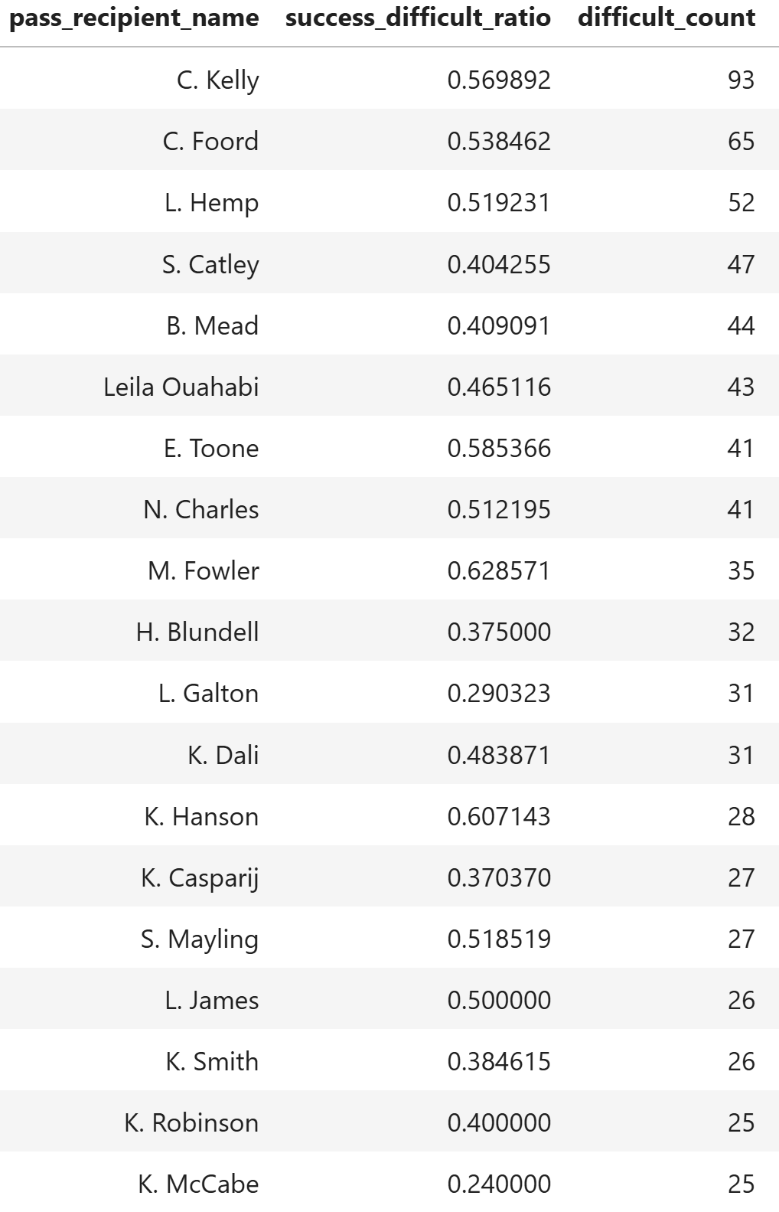
4.1 Attacker Evaluation
Among attacker who have faced more 25 difficult scenarios from the evaluation set, Mary Fowler and Kirsty Hansen stood out with their over 0.6 success ratio.

Slide 12
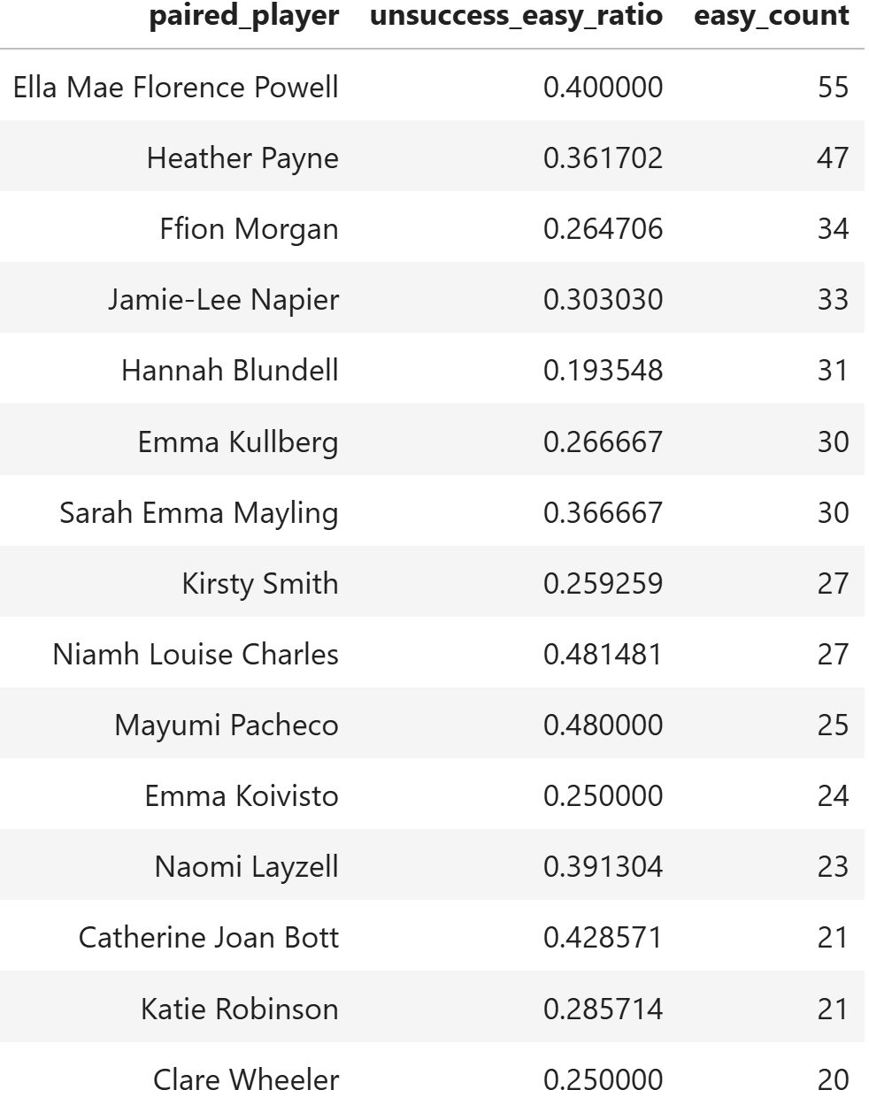
4.1 Defender Evaluation
Defender evaluation was focused on the 'paired players' who were the closest to the ball receiver at the start of sequence.
Among attacker who have faced more 20 difficult scenarios from the evaluation set, Ella Powell, Niamh Charles, Mayumi Pacheco, and Catherine Bott stood out with their over 0.4 prevent success ratio.

